Slide 1



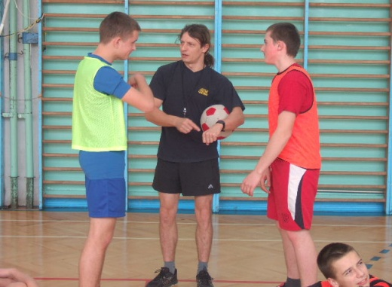
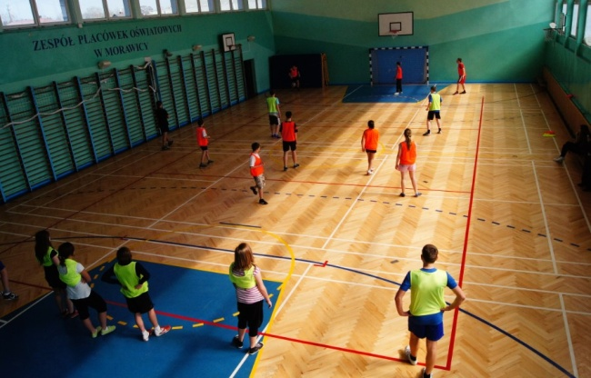
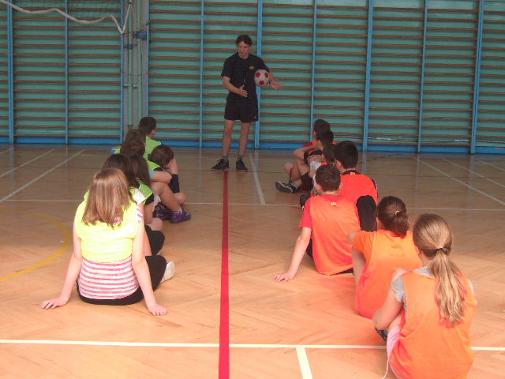
The Dodgeball Game
„W dwa ognie”
This project has been funded with support from the European Commission. This publication reflects the views only the authors and the European Commission cannot be held responsible for any use which may be made of the information conatained therein.

Slide 2
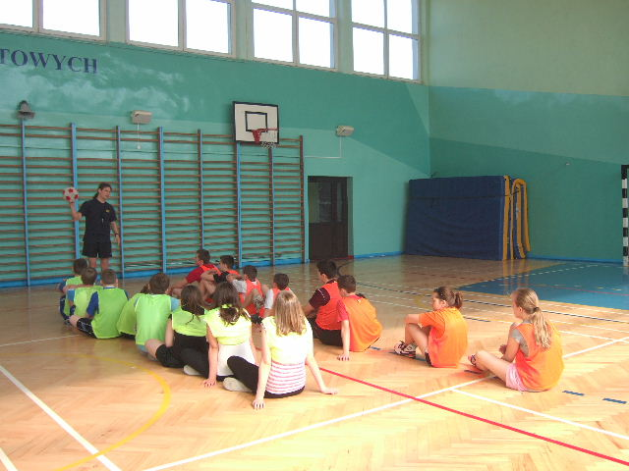
Number of players
Unlimited but it’s good to have 11players in each team.

Slide 3

The age of the players
7-16 years old.

Slide 4
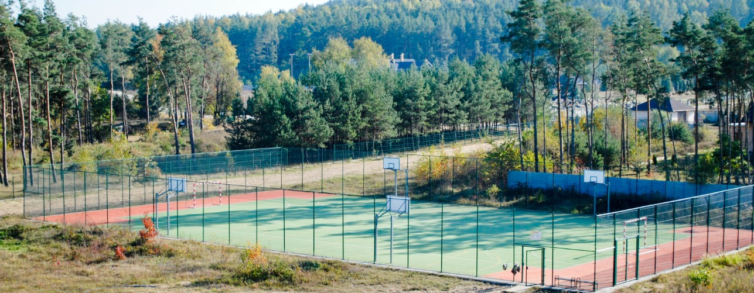
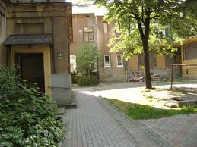
The places of the game
Outside (yard, pitch) or inside (gym).
Playground/ pitch
Yard

Slide 5


Equipment
Pitch: rectangular–size: 6-9x 12-18 steps long; soft ball, an inflated ball, sashes in two colours and six flags for outlining the field.
LINES

Slide 6
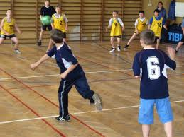
The aim of the game
To eliminate the members of the opposing team on the other side of the field.

Slide 7
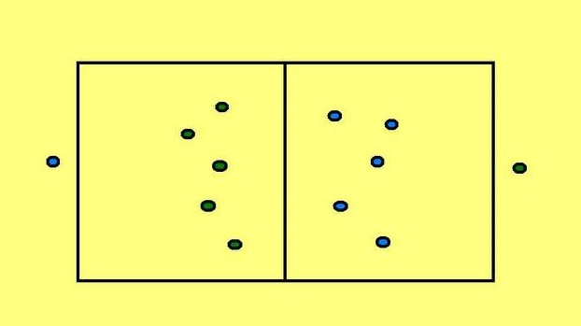
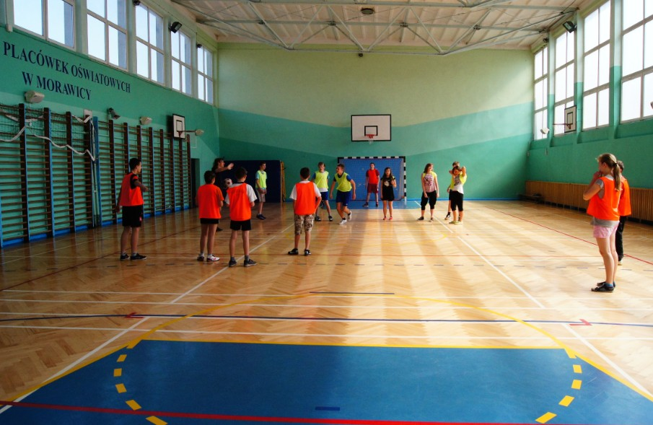
The players’ position
The players are forming two equal teams.
They’re choosing their captains called the kings. They’re standing in a loose cluster.
The players’ position in a game.
The players occupy the part of the pitch which was tossed out.

Slide 8
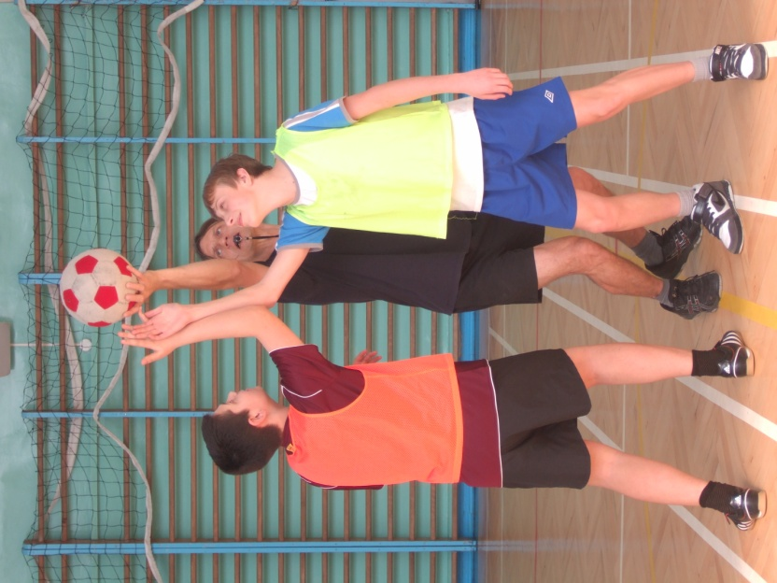

The captains
The captains fight for beginning of the game trying to throw the ball to their team tossed by the coordinator.
The captains stand behind the opponent's field and they ‘take him in a crossfire’ by throwing the ball from and to their teams.

Slide 9
The rules
The player, who catches the ball at the beginning of the game, throws it against the opponents. They protect themselves against hitting by ducking, jumping or escaping to the most distant angle of their field, trying not to cross its borderlines.
Every player can get the knock-out ball for his team if he lies down having both feet on the field and he can reach the ball.
The player, who rolls or come out of the field on both feet (or even one foot), is a „beaten” person. In this way, there are more and more players standing by the captain, and less and less players inside the field.

Slide 10
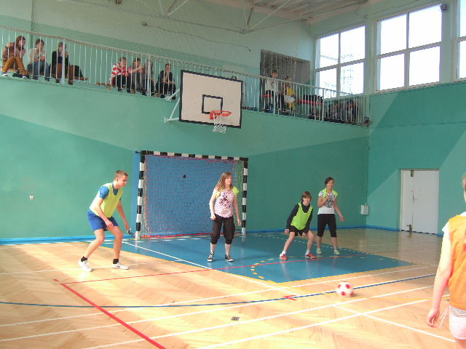
Beating the player
If any player hits the escaping opponent, the beaten person stands by his captain and helps him to ‘heighten the fire’.

Slide 11
What happens if the ball is out of the field?
If the ball rolls out the field, nobody is allowed to run after it. The ball is taken by the captain on his part of the field.
The ball should be taken by the captain in whose direction it is rolling out.
The ball which is on out position can be captured by each of the players who are laying on the ground or having the feet on the field at the moment when the ball is crossing the border line.

Slide 12
The rules c.d.
After beating everyone, the captain goes in the field. He’s got the right to be beaten three times. This team wins, which earlier had eliminated the opponents with their captain. If the game is supposed to continue, the winning team gets one point.

Slide 13
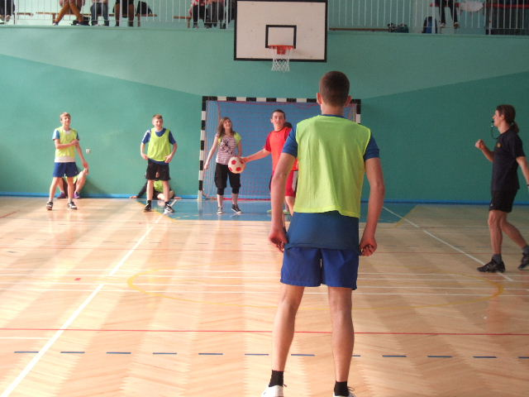
The captains’ final battle
After beating all players, the two captains are fighting against each other. The looser is that who was hit 3 times with a ball.

Slide 14
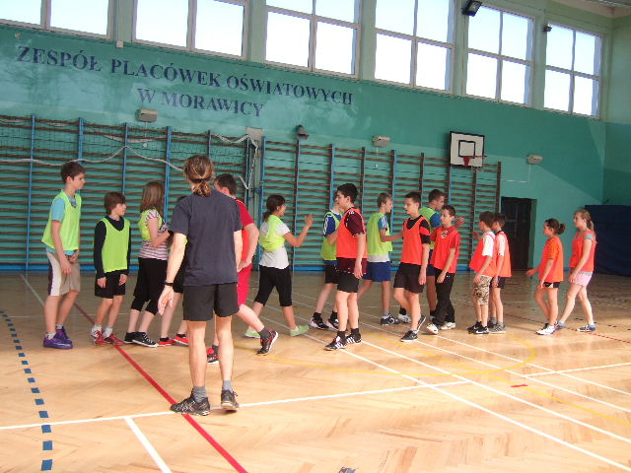

The end of the game
The winner is this team which had eliminated earlier the opponents with their captain. If the game is supposed to continue, the winning team gets one point.

