Slide 1



The caps’ game
Gra w kapsle
This project has been funded with support from the European Commission. This publication reflects the views only the authors and the European Commission cannot be held responsible for any use which may be made of the information conatained therein.

Slide 2
The caps’ game
Caps playing is the game which uses the bottle caps which are snapped along a defined route.
This game can be a great idea for the whole family who wants to spend time together in an active way.

Slide 3
About the game
During 1980s there were extremely popular so called ‘peace rallies’. The games in the shape of a rally were conducted along the set rail, where the caps inside were coloured to symbolize the flags of particular countries- these which took part in the real Peace Rally. The flags were stuck by means of plasticine or transparent plastic. They were usually made by the players themselves by cutting them from encyclopedias or atlases.

Slide 4

How to make the caps?
The caps may be filled with wax, plasticine or they can be empty.You must stick a „little shirt” on top of them. It can present an animal, a car, a flag, the name of favourite sportstar, etc.
The caps must be numbered somehow to make the recognition of the participants.

Slide 5
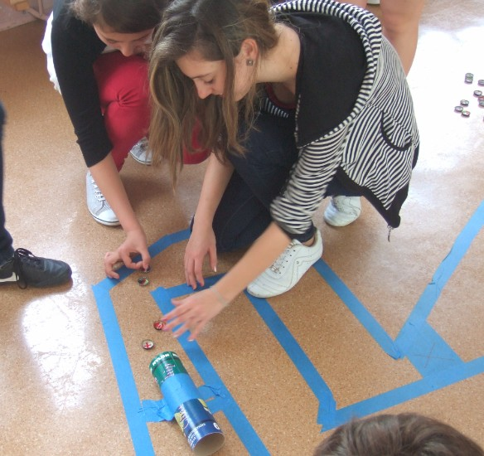
The number of players
It depends on the length and the width of the trail. The game is more interesting when at least four – five players take part in it.
The more players, the wider route should be.

Slide 6

The age of the players
Over 6 years old.

Slide 7
The aim of the game
The aim is to win the race and overcome obstacles which are on the route.
The caps substitute the real players.

Slide 8
Where can you play this game?
Places
pavement
outside
beach
classroom

Slide 9
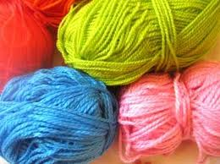
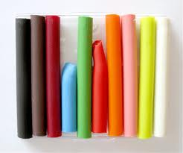
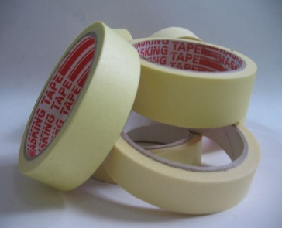
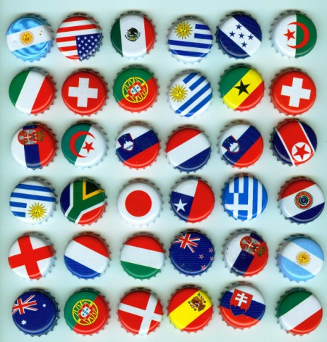
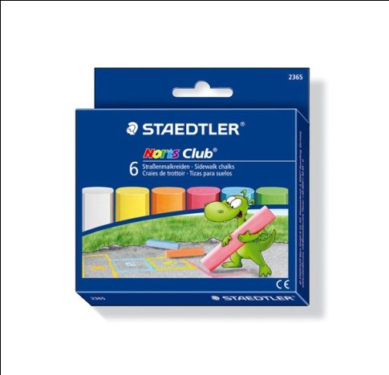
Equipment
wool
plasticine
masking tape
caps
chalk

Slide 10
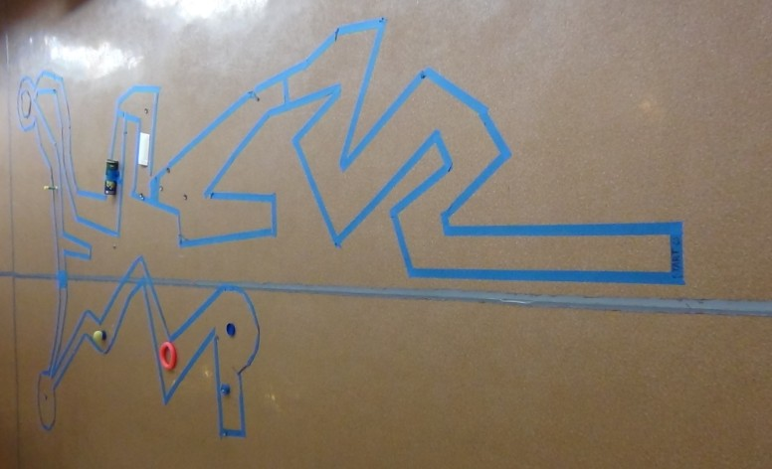
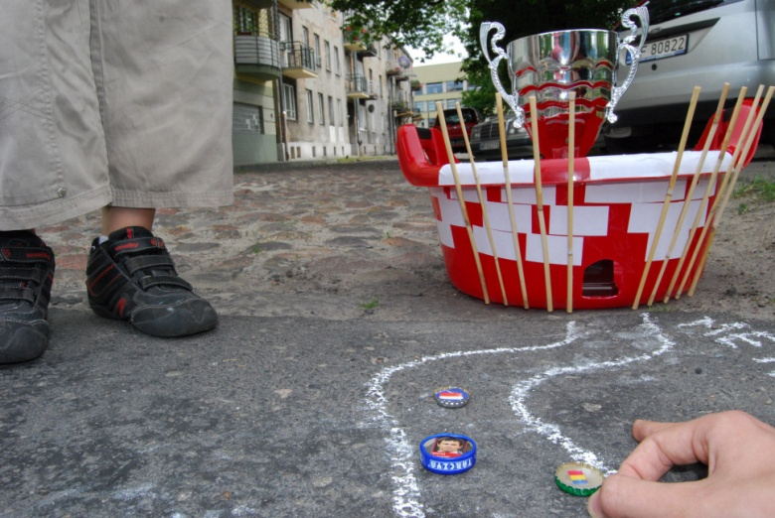
The route
It depends on our imagination. There should be lots of obstacles such as: a tunnel, a hill, a bridge, a sharp curve. You should also take into consideration the time you may afford to play this game.

Slide 11
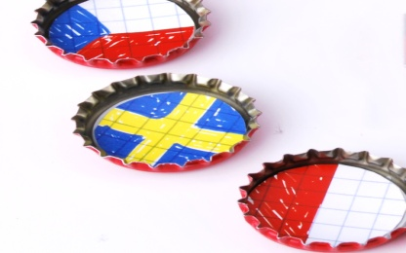
How is the game played?
1.The game starts at the starting line and the players draw lots to start.
2.The participant has only one hit during one turn.
3.The cap always needs to follow the route. You mustn’t take any shortcuts.
4.The cap needs to stop within the route set by the lines or needs to touch it.
5.If the cap after being snapped is out of the trail, the player must come back to the previous place both after the player’s hit or after being hit by the opponent’s cap.
6.The game of a player is finished if his/her cap crosses the finish line with its circumference.

Slide 12
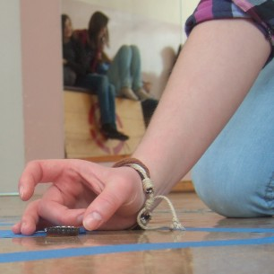
The rules of the game
One round is one snap. The winner is the person who can hit the caps the strongest and the most precisely.
You must snap the cap.

Slide 13
Individual races
Another type of the caps’ game is individual race of the players. Each participant finishes the track individually. The winnner is the person who finishes the race using the smallest number of movements.

Slide 14
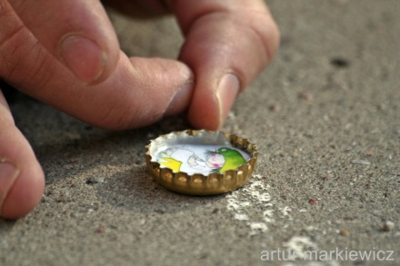
Team races
If we have more players we can try to organize team competition and then the victory goes to the team who scored more points; e.g. in a game took part 15 players (5 teams 3 players each) so in this game the first player gets 15 points, the second 14 etc. the total of received points decides about the each team’s place.
If teams have equal number of points then the place of the best player decides about the place of the team.

Slide 15
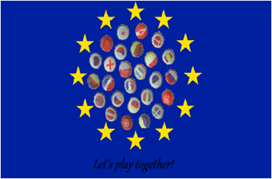
Thank you for your attention !

